Slide 1
Middle Tennessee Science AND Engineering Fair 2025
Information for the 2025 Fair
Notes:
2023 will be the 70th year of MTSEF

Slide 2
MTSEF is beginning its 71st year

Slide 3
MTSEF’s Host History
2016 - present

Slide 4
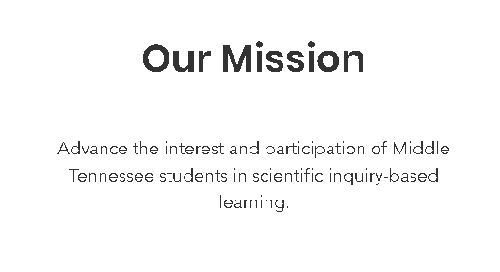
MTSEF’s Mission and Goals

Slide 5
MTSEF and Regeneron ISEF
Middle Tennessee Science & Engineering Fair (MTSEF) – an ISEF affiliated fair
Regeneron International Science & Engineering Fair (ISEF) (https://www.societyforscience.org/isef/)
MTSEF follows rules and guidelines established by the ISEF
Questions: Dr. Steve Murphree (steve.murphree@belmont.edu)
SRC = Scientific Review Committee: reviews all projects
Check MTSEF website for dates and other relevant information:
https://www.mtsef.org/
STEM Wizard for Registration and Operation of MTSEF:
https://mtsef.stemwizard.com/
Forms and additional details regarding the rules and guidelines for MTSEF and ISEF projects can be found at:
https://student.societyforscience.org/international-rules-pre-college-science-research

Slide 6
MTSEF’s Website

Slide 7
MTSEF’s STEM Wizard Website

Slide 8
Important Dates –2025
IRB preapprovals are now completed at the school-level, not by MTSEF’s Scientific Review Committee.
Tuesday, January 31, 2025: Deadline for all SRC and IRB preapprovals (human participants, vertebrate animals, potentially hazardous biological agents (microorganisms, recombinant DNA, tissues).
Friday, March 1 ,2025: MTSEF entry deadline for all milestones except Abstracts on STEM Wizard.
Monday, March 19, 2025: MTSEF entry deadline for all milestones including Abstracts on STEM Wizard.
Friday, March 21, 2025 MTSEF at the Ayers Academic Center 4th floor Conference Center, Belmont University,
Project Set-up: 2:00- 5:30 p.m.
Judging: 6:30 – 8:00 p.m., Students need to be at projects.
Project Removal (except for Grand Prize judging projects): 8:00 – 8:30 p.m.
Grand Prize judging (by invitation only): 8:30 – 9:30 p.m.
Monday, April 7 2025, 6:30 – 8:00 p.m.: Awards Ceremony at Ayers Academic Center 4th floor Conference Center, Belmont University.
Notes:
MNPS Spring Break: March 10-14, 2024; Belmont Spring Break: March 10-14, 2024

Slide 9
Process for Students
Question
Observe
Design
Develop hypothesis
Pre-Approval?
Determine if pre-approval is needed by IRB or SRC
Read literature
Talk with others
Design experimental/observational plan
Conduct Project
Submit Project
Attend MTSEF
Collect & analyze data
Create graphs/diagrams
Create poster
Triple check that all forms are completed properly
Have fun!

Slide 10
OVERVIEW
IRB
Projects involving human participants
SRC Pre-Approvals
Projects involving human participants (pre-approved at school level), vertebrate animals, potentially hazardous biological agents (microorganisms, recombinant DNA, tissues)
All Approvals
All projects with all forms submitted
Pre-approvals completed at school level (not by MTSEF)
MTSEF
Awards Ceremony
1-2 days at Belmont University
~ 1.5 hours at Belmont University
Awards: Category & Special
Certificates, medallions, monetary awards
- Grand Prize Winners (2 high school projects) attend ISEF
- 6-8 Middle School Winners enter Thermo Fisher Junior Innovators Challenge
Check MTSEF website for dates/deadlines: https://www.mtsef.org/

Slide 11
Scientific Review Committee (SRC)
Reviews some projects before experimentation
Reviews all projects just prior to competition
Membership must include:
Biomedical scientist (Ph.D., M.D., D.V.M., D.D.S, PharmD., D.O.)
Educator
One other member
The SRC examines projects for the following:
Evidence of literature search
Evidence of proper supervision
Use of accepted research techniques
Completed forms, signatures, & dates
Evidence of search for alternatives to animal use
Humane treatment of animals
Compliance with rules & laws governing human & animal research
Appropriate use of recombinant DNA, pathogenic organisms, controlled substances, tissues & hazardous substances & devices
Appropriate documents & substantial expansion for continuation projects

Slide 12
SRC Process
Before Experimentation
Projects involving HUMAN PARTICIPANTS
All schools must form their own IRB committee to approve projects involving HUMANS (see ISEF guidelines)
SRC reviews forms and projects for compliance
After Experimentation
All Projects: those previously approved and ALL OTHER projects to ensure Research Plan & Rules were followed
Projects involving VERTEBRATE ANIMALS
Projects involving POTENTIALLY HAZARDOUS BIOLOGICAL AGENTS (MICROOGANISMS, RECOMBINANT DNA, TISSUES)
SRC reviews forms and projects for compliance
SRC Reviews ALL forms & projects then notifies researcher of SRC decision by email

Slide 13
HELPFUL WEBSITES
Rules Wizard (your best friend!!)
https://ruleswizard.societyforscience.org/
Overview of Rules
https://student.societyforscience.org/international-rules-pre-college-science-research
Forms
https://www.societyforscience.org/isef/forms/
(Also Available when students register using STEM Wizard)

Slide 14
Required SRC Forms & Info: ALL Projects
Entry form
Checklist for Adult Sponsor (1)
Student Checklist (1A)
Approval Form (1B)
Research Plan: see Research Plan Instructions for detail) – Must incorporate all of the relevant topics listed in the instructions
250 Word Abstract (after experimentation)
Regulated Research Institutional/Industrial Setting Form (1C): Studies conducted at a research institution, industrial setting, or any work site other than home, school, or field – if applicable
Continuation Form (7) –Projects based on prior research in the same field of study, Longitudinal studies are permitted (multi-year study or studies of a time-based change; Documentation of substantial expansion from previous projects) - if applicable
Evidence of literature search (we expect to see at least 3 references)

Slide 15
Required SRC Forms: SOME Projects
Some projects require additional forms:
Human Subjects: Must have IRB & SRC approval prior to experimentation
Human Participants Form (4) or IRB approval form from an RRI and all applicable consents and survey(s)
Human Informed Consent form (sample) - recommended
Qualified Scientist Form (2) – if applicable
Regulated Research Institution Form (1C) - if applicable
Risk Assessment (3) – if applicable
Vertebrate Animals: Must have SRC approval prior to experimentation
Non-regulated site: Vertebrate Animal Form (5A)
e.g. home, school, farm, ranch, field if the following applies: research involves behavioral, observational, or supplemental nutritional studies on animals & non-invasive/non-intrusive methods that do not negatively affect an animal's health or well-being
Regulated site: Vertebrate Animal Form (5B) + Qualified Scientist Form (2)
Potentially Hazardous Biological Agents: Must have SRC approval prior to experimentation
Potentially Hazardous Biological Agents Risk Assessment Form (6A)
Human & Vertebrate Animal Tissue Form (6B)
Qualified Scientist Form (2) – if applicable
Risk Assessment Form (3) – if applicable
Hazardous Chemicals, Activities, & Devices
Qualified Scientist Form (2)
Risk Assessment Form (3)
Regulated Research Institution Form (1C) – if applicable
If in doubt:
Check Rules Wizard https://ruleswizard.societyforscience.org/
Ask SRC chair:samadidanas@apsu.edu

Slide 16
Definitions
ADULT SPONSOR: Oversees project to make sure that student
Is informed of ISEF Rules and Guidelines
Is aware of risks associated with project
Is aware of forms required for project
Will receive proper supervision during experimentation
If required, submits projects to IRB or SRC
QUALIFIED SCIENTIST: Required for some projects
Doctoral/professional degree related to student research OR Master’s degree with SRC approval
Completes Qualified Scientist Form (2)
DESIGNATED SUPERVISOR
Animal Care Supervisor for vertebrate animal projects
Supervises projects involving hazardous chemicals, activities, or devices
Supervises projects requiring a Qualified Scientist When the Qualified Scientist cannot directly supervise the student

Slide 17
IRB (Institutional Review Board)
Definition
Reviews human participants studies
Guidelines
Human participants studies involve living individuals where there is:
Process
IRB must review and approve the research plan BEFORE experimentation begins
Membership must include:
An educator
A school administrator
Someone knowledgeable about evaluating physical and/or psychological risk: MD, PA, RN, psychologist, licensed social worker, or licensed clinical professional counselor
Intervention or interaction with participants
And/Or
Collection of identifiable private information
IRB decisions are documented on Human Subjects Form (4)
If IRB determines that written informed/consent/assent or parental permission is required, document on
Human Informed Consent Form
Research participants 18 years of age or older must give informed consent
Research participants under 18 must give assent and their parents may be required to give permission
The IRB evaluates the project and determines
Risk level (see future slide)
Requirement for Qualified Scientist
Requirement for written informed consent/assent/parental permission
Projects that are conducted at school, at home or in the community that are not aﬃliated with a Regulated Research Institution (RRI) must be reviewed and approved by the School IRB before the student may begin recruiting and/or interacting with human participants. The School IRB must assess the risk and document its determination of risk on Form 4. https://student.societyforscience.org/human-participants

Slide 18
IRB: Informed Consent/Assent (Recommended)
Adult research participants may give their own consent.
Research participants under 18 years of age and/or individuals not able to give consent (e.g. developmentally disabled individuals) give their assent, with the parent/guardian providing permission.
The School IRB will determine whether the consent/assent/ parental permission may be a) verbal or implicit or b) must be written. See the Risk Assessment information and the online Risk Assessment Guide for further explanation of informed consent.
Informed consent requires that the researcher provides complete information to the participant (and where applicable, parents or guardians) about the risks and benefits associated with participation in the research study.
Participants must be informed that their participation is voluntary and that they are free to stop participating at any time with no adverse consequences of non- participation or aborted participation.
Informed consent may not involve coercion.
When written parental permission is required and the study includes a survey, the survey must be attached to the consent form.
The student researcher may request that the IRB waive the requirement for written informed consent/parental permission in his/her research plan if the project meets specific requirements (next slide)
https://student.societyforscience.org/human-participants

Slide 19
IRB: Waiver of Informed Consent/Assent
IRB Waiver of Written Informed Consent/Parental Permission (https://student.societyforscience.org/human-participants)
The IRB may waive the requirement for documentation of written informed consent/assent/parental permission if the research involves only minimal risk and anonymous data collection and if it is one of the following:
Research involving normal educational practices
Research on individual or group behavior or characteristics of individuals where the researcher does not manipulate the participants’ behavior and the study does not involve more than minimal risk.
Surveys, questionnaires, or activities that are determined by the IRB to involve perception, cognition, or game theory, etc. and that do NOT involve gathering personal information, invasion of privacy or potential for emotional distress.
Studies involving physical activity where the IRB determines that no more than minimal risk exists and where the probability and magnitude of harm or discomfort anticipated in the research are not greater than those ordinarily encountered in DAILY LIFE or during performance of routine physical activities.
If there is any uncertainty regarding the appropriateness of waiving written informed consent/assent/parental permission, it is strongly recommended that documentation of written informed consent/assent/parental permission be obtained.

Slide 20
IRB: EXEMPT studies – do not require IRB review nor human participant forms
Product testing of a student invention, program, concept, etc. that only the researcher is testing
No health hazards
No personal data collected
Feedback directly related to product
Studies using pre-existing, publicly available human data
Behavioral observations in unrestricted public settings
No interaction
No manipulation of environment
No recording of any personal identifiers
Studies using certified de-identified/anonymous data
For details: https://student.societyforscience.org/human-participants

Slide 21
Risk Evaluation
ALL projects have some level of risk!
No more than minimal risk
Anticipated harm and discomfort not greater than encountered in daily life
More than minimal risk
Anticipated harm or discomfort is greater than encountered in daily life
More than minimal risk studies should require written consent/assent and parental permission. Final determination for this requirement made by the IRB.
TYPES OF RISK
Physical risks
Exercise
Ingestion, tasting, smelling, application of substances
Exposure to potentially hazardous material
Psychological risks
Invasion of privacy
Participant is a member of an at-risk group

Slide 22
Vertebrate Animals
What are Vertebrate Animals?
Live, nonhuman vertebrate mammalian embryos or fetuses
Prohibited Vertebrate Animal Studies
Induced toxicity studies involving known toxic substances that could impair health or destroy life
Bird and reptile eggs within 3 days of hatching
All other nonhuman vertebrates (including fish) at hatching or birth
Zebrafish embryos 7 days (168 hours) post fertilization
Behavioral experiments with:
Conditioning using aversive stimuli
Mother/infant separation
Induced/learned helplessness
Studies of pain
Predator/invertebrate prey experiments
NO vertebrate animal deaths due to the experimental procedures are permitted
Studies designed or anticipated to cause vertebrate animal death are prohibited
Any deaths must be investigated by a qualified individual
If death was the result of experimental procedure, the study must be terminated and the study will not qualify for competition
Behavioral Observations of Vertebrate Animals EXEMPT from SRC Pre-Approval
There is no interaction with the animals
AND
There is no manipulation of the environment
AND
All federal or state fish, game, and wildlife regulations are followed

Slide 23
Vertebrate Animal Research Sites
School/Home/Field
Agricultural, behavioral, observational, or supplemental nutritional studies
Regulated Research Institution (must have IACUC review & approval process): Universities, Gov’t Research Agencies, Private Research Labs
Must be approved by IACUC (Institutional Animal Care and Use Committee)
AND
Non-invasive and non-intrusive with no negative effect on animal’s health or well-being
AND
Require SRC pre-review and approval
SRC reviews project before experimentation
Experimentation must follow ISEF guidelines
Qualifies Scientist completes:
Vertebrate Animal Form (5B), with documentation of IACUC approval
Qualified Scientist Form (2)
SRC determines level of supervision appropriate for the study:
Designated supervisor
Veterinarian
Qualified scientist
Vertebrate Animal Form (5A) required

Slide 24
Potentially Hazardous Biological Agents (PHBA)
Includes:
Microorganisms (including bacteria, viruses, fungi, etc.)
Recombinant DNA
Human or animal fresh/frozen tissues, blood, or body fluids
Studies must have prior approval by SRC/IACUC/IBC
Most studies are prohibited in a home environment
Studies intended to genetically engineer bacteria with multiple antibiotic resistance are prohibited
Lab studies utilizing MRSA, VRE, and KPC must be conducted in a Regulated Research Institution under documented IBC review and approval

Slide 25
Risk Assessment of PHBA
Assessing Risk
Required of all PHBA projects
Laboratories
BSL 1 studies can usually be conducted in a high school or college teaching laboratory.
Defines potential level of harm, injury or disease to plants, animals, or humans
Involves:
Assignment of biological agent to risk group
Determination of level of biological containment
Assessment of expertise of adult(s)
Assignment of final biosafety level
BSL 2 studies are usually conducted in a regulated research institution.
BSL 3 & BSL 4 studies are prohibited for ISEF projects.
Most projects involving microorganisms, and all projects involving rDNA, or fresh human and vertebrate animal tissues require:
Potentially Hazardous Biological Agents Form 6A
How can I determine if my laboratory is a BSL 1 or BSL 2 laboratory?
There are no outside agencies which certify BSL 1 or 2 laboratory facilities. There are criteria published by the World Health Organization and CDC-NIH which list the guidelines and practices required to attain BSL-1 and BSL-2 compliance. These criteria are described in the World Health Organizations “Laboratory Biosafety Manual” and in Biosafety in Microbiological and Biomedical Laboratories published by CDC-NIH The criteria are available for ISEF affiliated fairs as self-assessment checklists for laboratories serving as sites for BSL 1 and BSL 2 studies. These checklists are available on the ISEF website. High school biology laboratories normally meet the BSL-1 criteria. If BSL-2 studies are being conducted in a high school lab, it is recommended that the BSL-2 checklist be completed to document that all of the criteria are met.

Slide 26
PHBA Definitions and Details
Unknown Microorganisms
BSL 1 if
rDNA Technologies
Experiments with BSL 1 organisms can be done in BSL 1 lab with a Qualified Scientist or trained DS
Tissues
If animal is euthanized solely for student project = vertebrate animal study which requires IACUC approval
Organisms cultured in plastic petri dish
Culture dish remains sealed throughout experiment
Culture dish disposed of in appropriate manner
BSL 2 if petri dish is opened
Experiments with BSL-2 organisms must be done in a regulated research institution with a Qualified Scientist
If animal is euthanized for a purpose other than student project = tissue study
Classification as BSL 1 or 2 based on source of tissue and possibility of containing infectious agents
All studies with human or wild animal blood are BSL 2.
Studies with domestic animal blood are BSL 1.
Studies with human body fluids which can be associated with a person must have IRB approval.
Human & Vertebrate Animal Tissue
All projects using:
Fresh/frozen tissue
Primary cell cultures
Human and other primate established cell lines and tissue cultures
Blood and blood products
Body fluids
Require Human and Vertebrate Animal Tissue Form 6B

Slide 27
PHBA Studies Exempt from Pre-SRC Review
No Additional PHBA Forms Required
Studies using baker’s and brewer’s yeast (except rDNA studies)
Studies using Lactobacillus, B. thuringiensis, nitrogen-fixing bacteria, oil-eating bacteria, and algae-eating bacteria in natural environment. Not exempt if cultured in a petri dish environment
Studies of mold growth on food items if experiment terminated at first sign of mold
Require Risk Assessment Form (3)
Studies involving protists, Archaea, and similar microorganisms
Research using manure for composting, fuel production, or other non-culturing experiments
Studies using commercially available color change coliform water test kits
Studies involving decomposition of vertebrate organisms (forensic studies)
PHBA Tissues that are Exempt
Plant tissues
Plant and non-primate established cell and tissue cultures
Fresh or frozen meat, meat by-products, pasteurized milk, & eggs – from grocery stores, restaurants, packing houses
Hair
Sterilized teeth
Fossilized tissue/archeological specimens
Prepared fixed tissue slides

Slide 28
Hazardous Chemicals, Activities, or Devices (HCAD)
Include:
Hazardous chemicals
Hazardous equipment/devices
Hazardous activities
DEA-Controlled substances
Prescription drugs
Alcohol and tobacco
Firearms and explosives
Radiation
Requires Risk Assessment Form (3)
Notes:
DEA = Drug Enforcement Administration

Slide 29
Hazardous Chemicals, Activities, or Devices (HCAD)
General Rules
Studies do not require prior SRC review and approval
Alcohol & Tobacco
Must follow local laws for purchase, possession, and consumption
Other
Prescription Drugs:
All studies
Require a Risk Assessment Form 3
DEA-controlled substances
Consult DEA list of controlled substances
Controlled substances on Schedule 1 require a DEA protocol review
Require a Qualified Scientist
All other studies require a
Designated Supervisor
Firearms & Explosives must adhere to local training and certification requirements
Home production of ethyl alcohol (wine or beer) must follow U.S. Alcohol and Tobacco Tax and Trade Bureau (TTB) regulations
Alcohol distillation for fuel production can be conducted at school with TTB permit obtained by school officials
Cannot be administered to human subjects
Animal administration must follow ISEF vertebrate animal guidelines
Hazardous Chemicals
Refer to MSDS Sheets for safety and handling guidelines
Hazardous Devices
Involve level of risk beyond that encountered in student’s everyday life
Radiation
Non-ionizing
Ionizing

Slide 30
HELPFUL WEBSITES
Rules Wizard (your best friend!!)
https://ruleswizard.societyforscience.org/
Overview of Rules
https://student.societyforscience.org/international-rules-pre-college-science-research
Forms
https://www.societyforscience.org/isef/forms/
(Available when students register using STEM Wizard)

Slide 31
Important Dates –2025
IRB preapprovals are now completed at the school-level, not by MTSEF’s Scientific Review Committee.
Tuesday, January 31, 2025: Deadline for all SRC and IRB preapprovals (human participants, vertebrate animals, potentially hazardous biological agents (microorganisms, recombinant DNA, tissues).
Friday, March 1 ,2025: MTSEF entry deadline for all milestones except Abstracts on STEM Wizard.
Monday, March 19, 2025: MTSEF entry deadline for all milestones including Abstracts on STEM Wizard.
Friday, March 21, 2025 MTSEF at the Ayers Academic Center 4th floor Conference Center, Belmont University,
Project Set-up: 2:00- 5:30 p.m.
Judging: 6:30 – 8:00 p.m., Students need to be at projects.
Project Removal (except for Grand Prize judging projects): 8:00 – 8:30 p.m.
Grand Prize judging (by invitation only): 8:30 – 9:30 p.m.
Monday, April 7 2025, 6:30 – 8:00 p.m.: Awards Ceremony at Ayers Academic Center 4th floor Conference Center, Belmont University.
Notes:
MNPS Spring Break: March 10-14, 2024; Belmont Spring Break: March 10-14, 2024

Slide 32
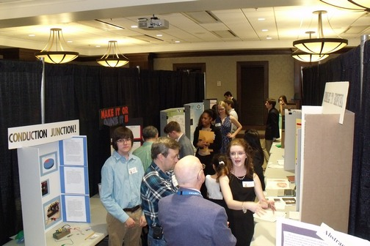
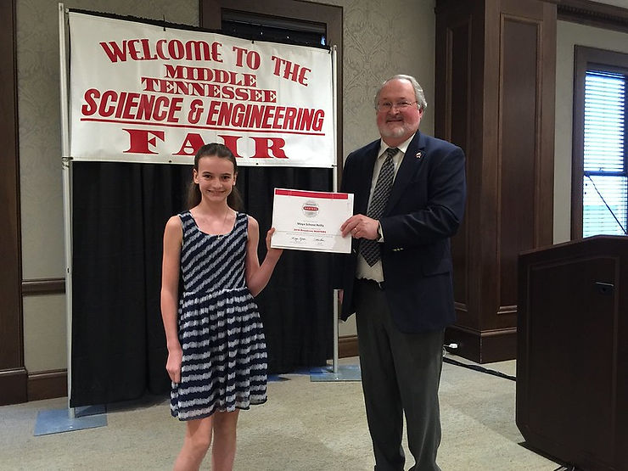
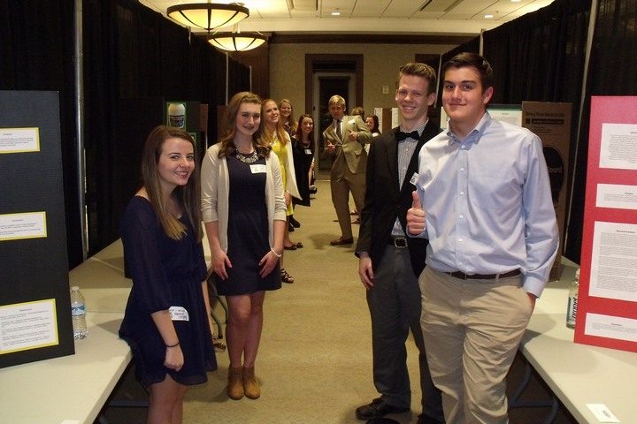

Slide 33
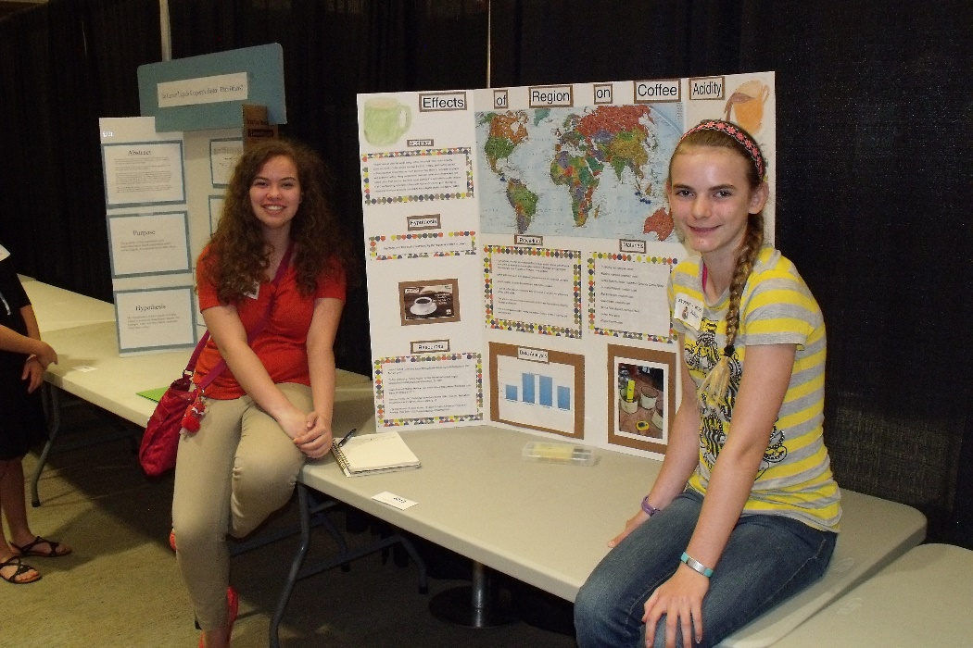
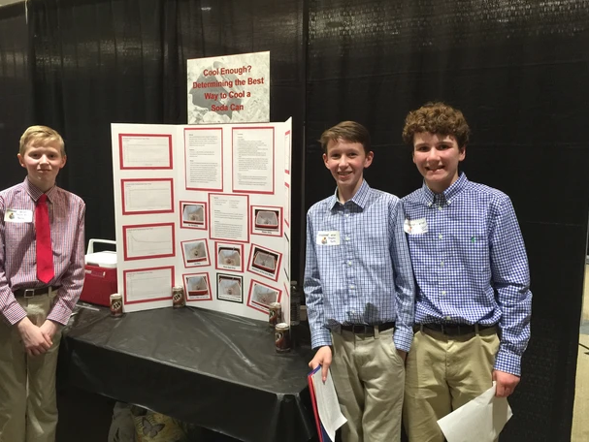
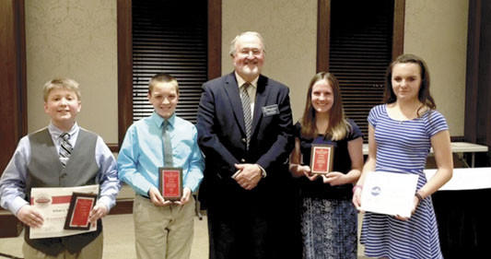

Slide 34
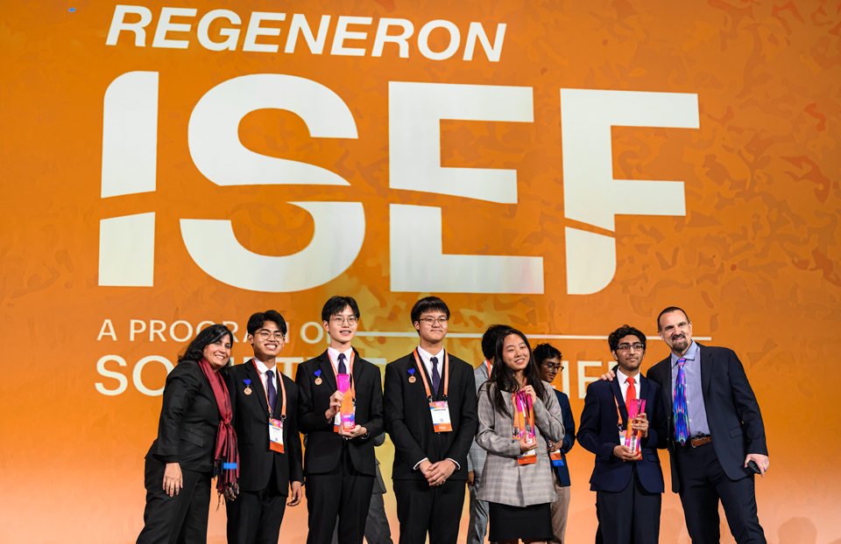
Three High School Grand Prize Winners will represent MTSEF at the Regeneron International Science and Engineering Fair May 10-16, 2025 in Columbus, Ohio!
Six Middle School Winners will represent MTSEF at the Virtual 2025 Thermo Fisher Junior Innovators Challenge

Slide 35
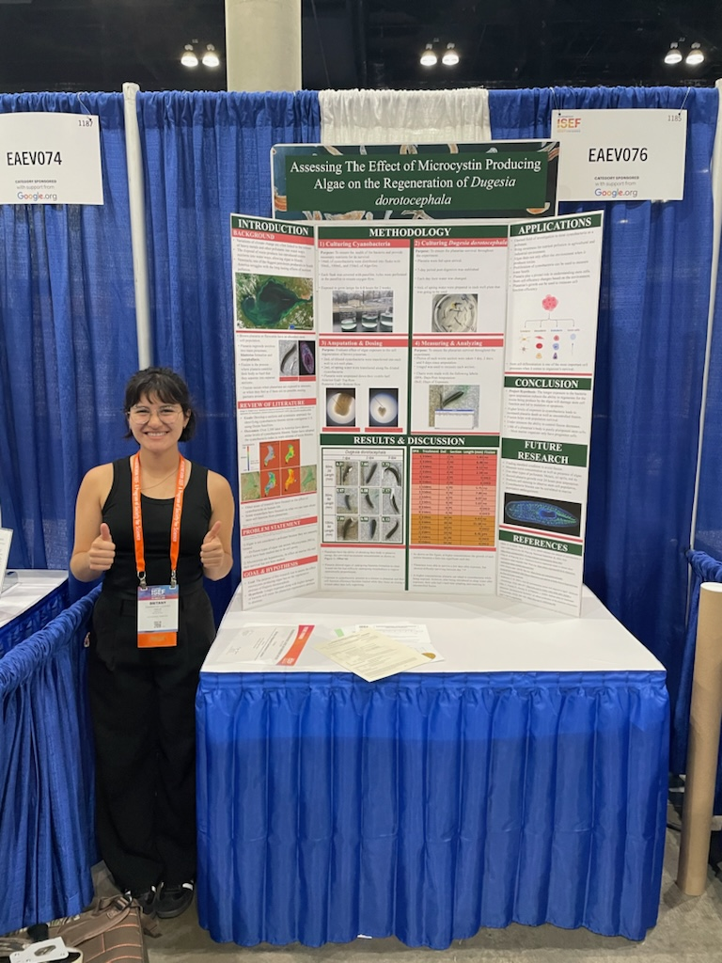
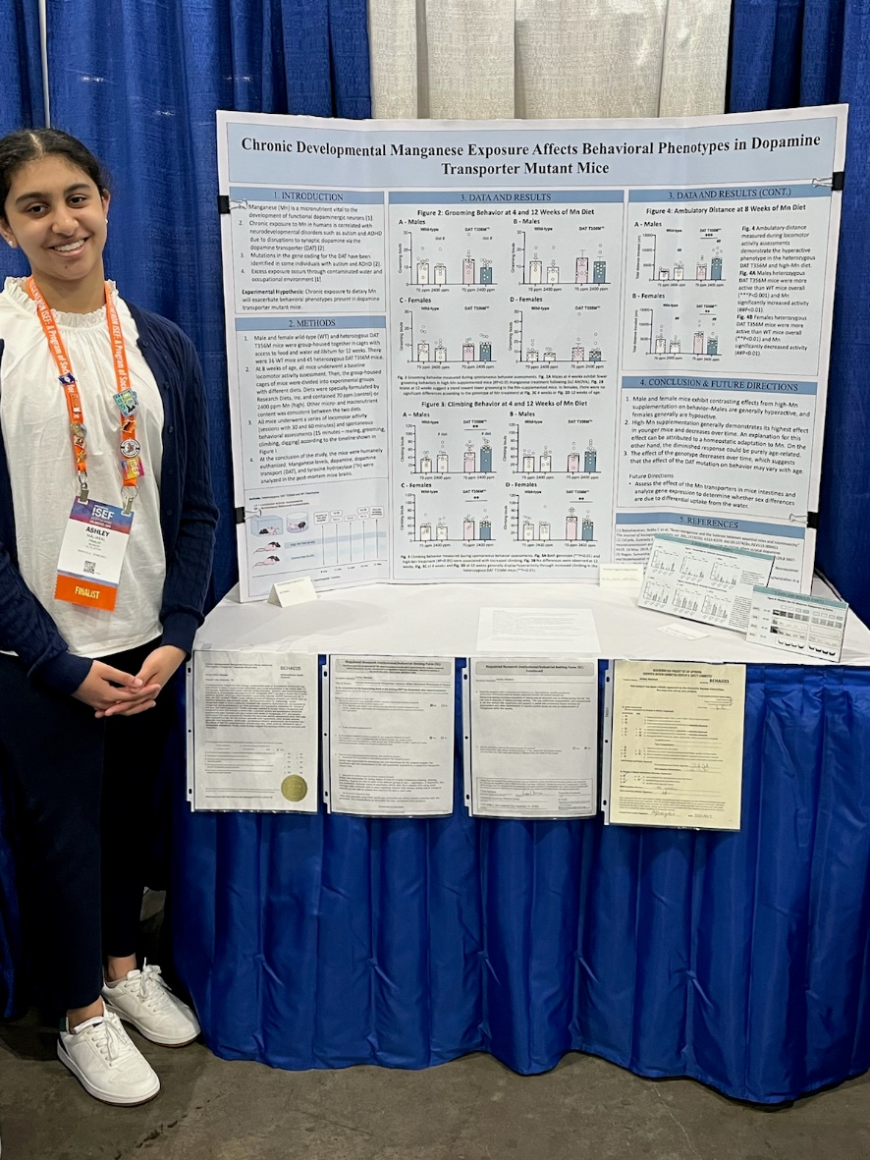
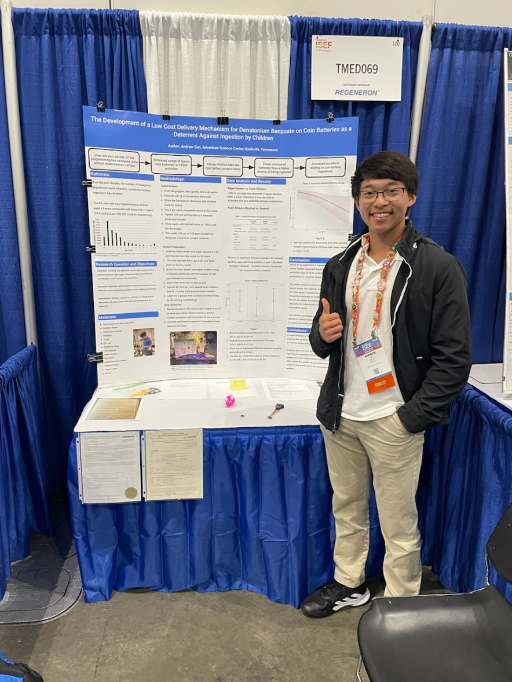
MTSEF Grand Prize Winners for 2024 –
Britany Zambrano, Ashley Maliakal and Andy Gan
at Regeneron ISEF in Los Angeles, California

Slide 36
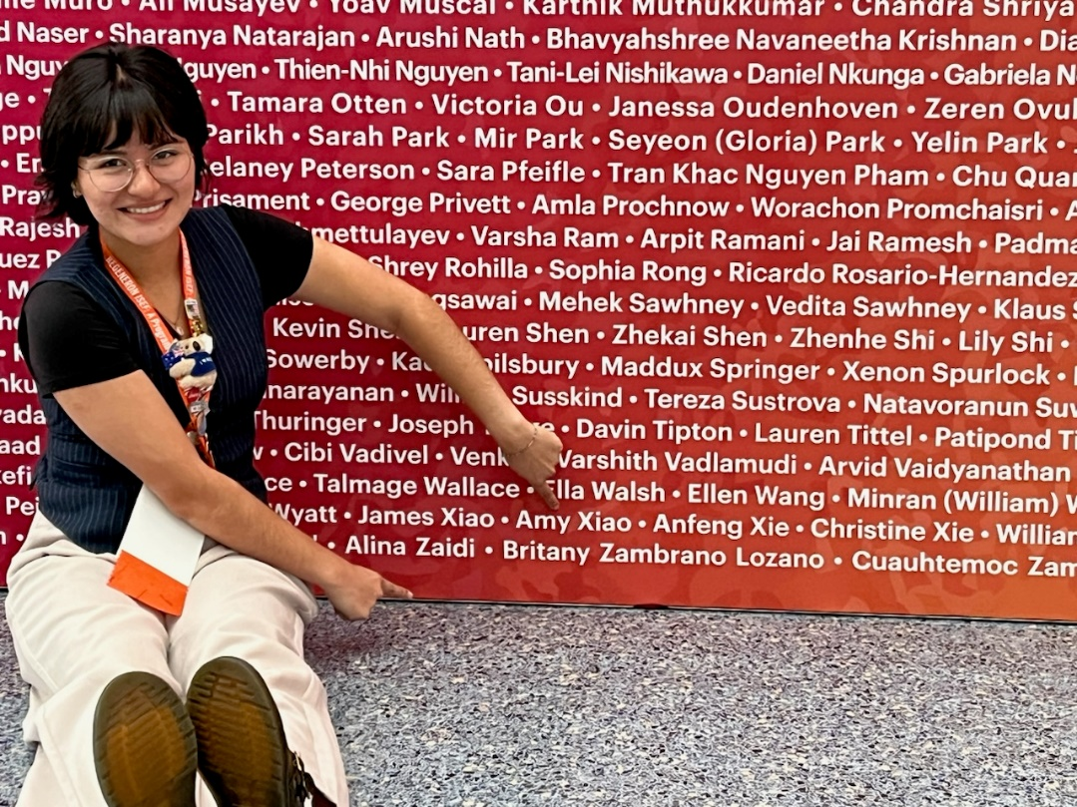
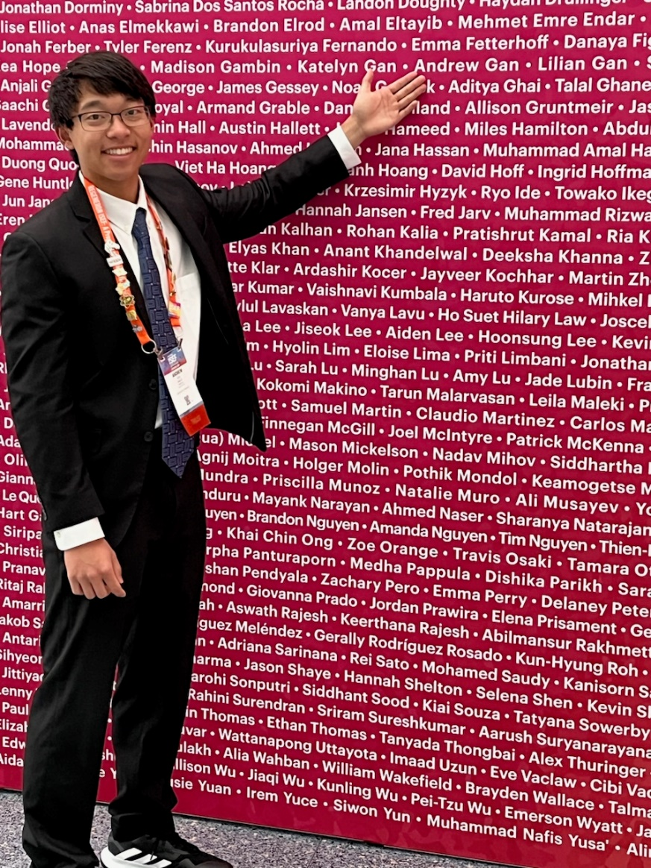
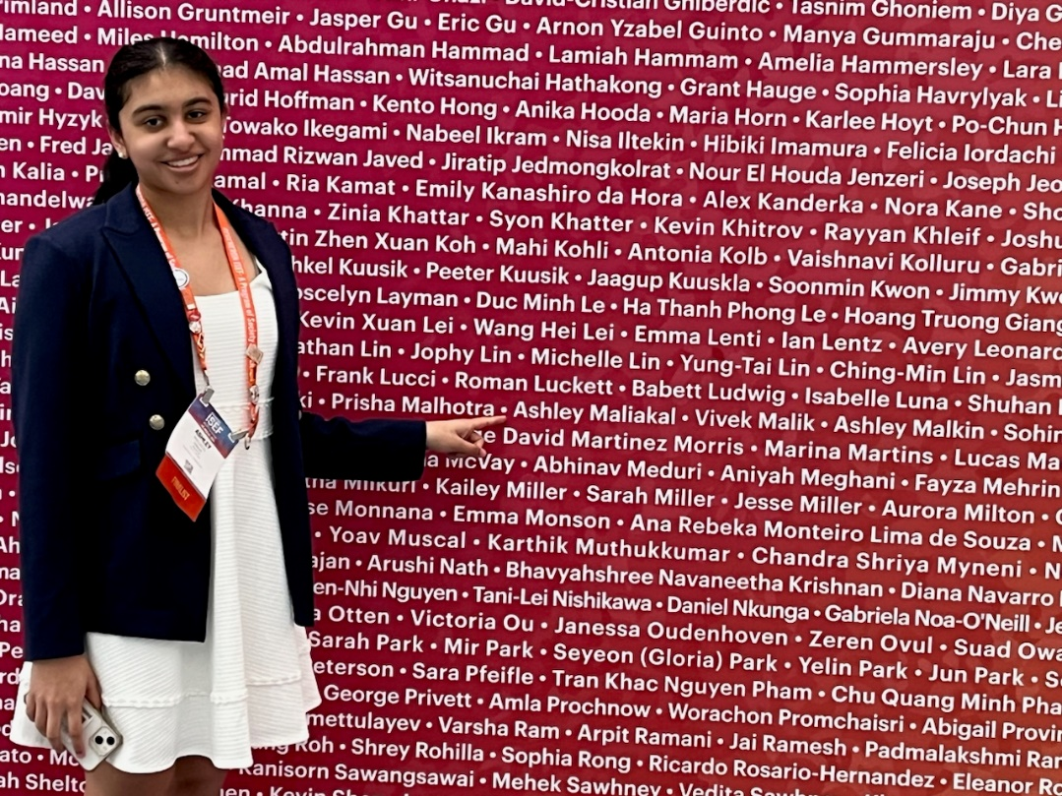
MTSEF Grand Prize Winners for 2024 –
Britany Zambrano, Ashley Maliakal
and Andy Gan
at Regeneron ISEF in Los Angeles, California

Slide 37
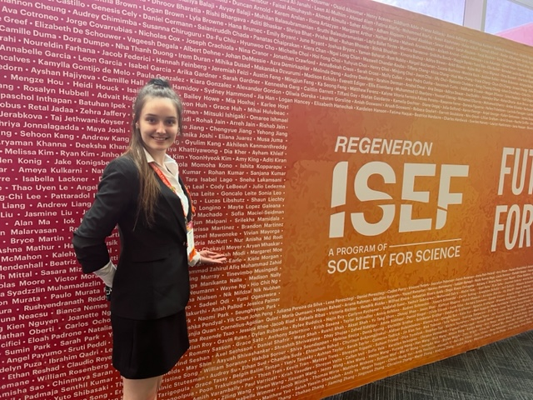
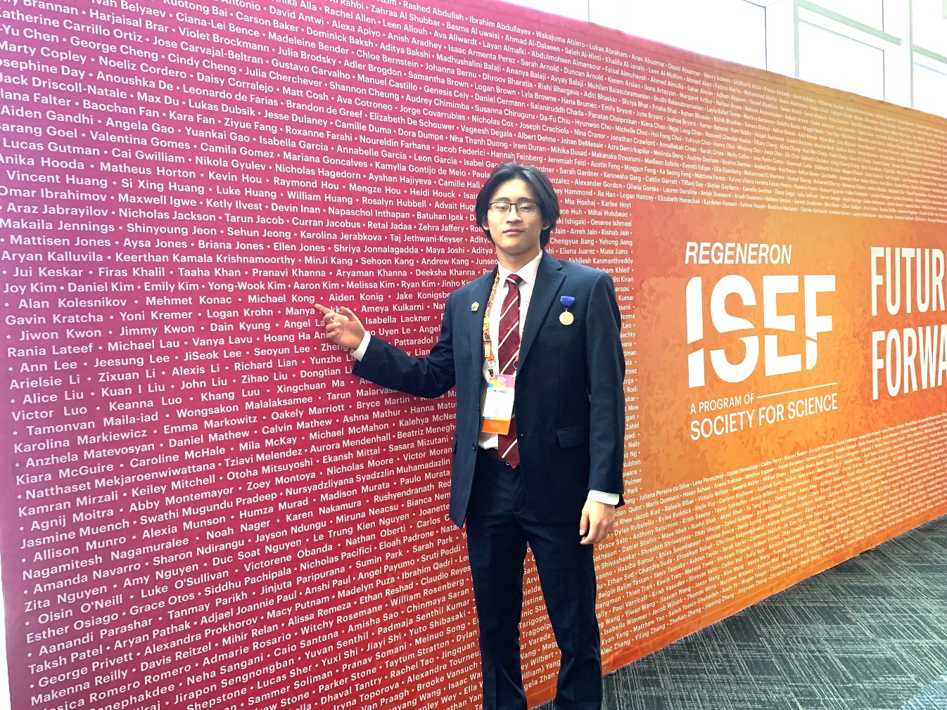
MTSEF Grand Prize Winners for 2023 –
Chekayli Meyer and Michael Kong
at Regeneron ISEF in Dallas, Texas

Slide 38
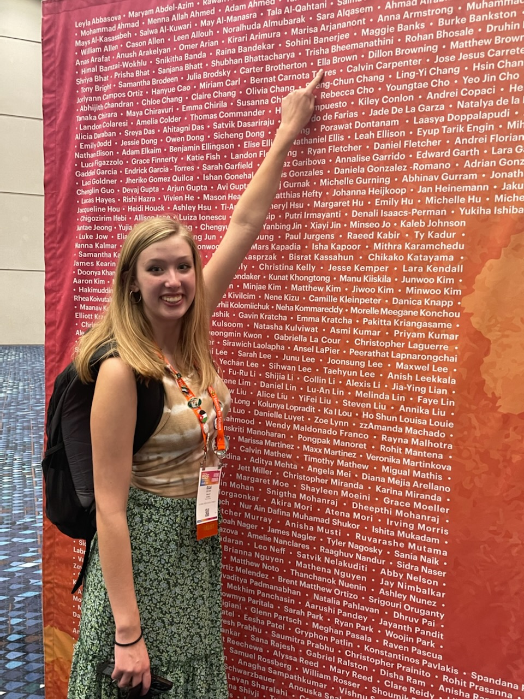
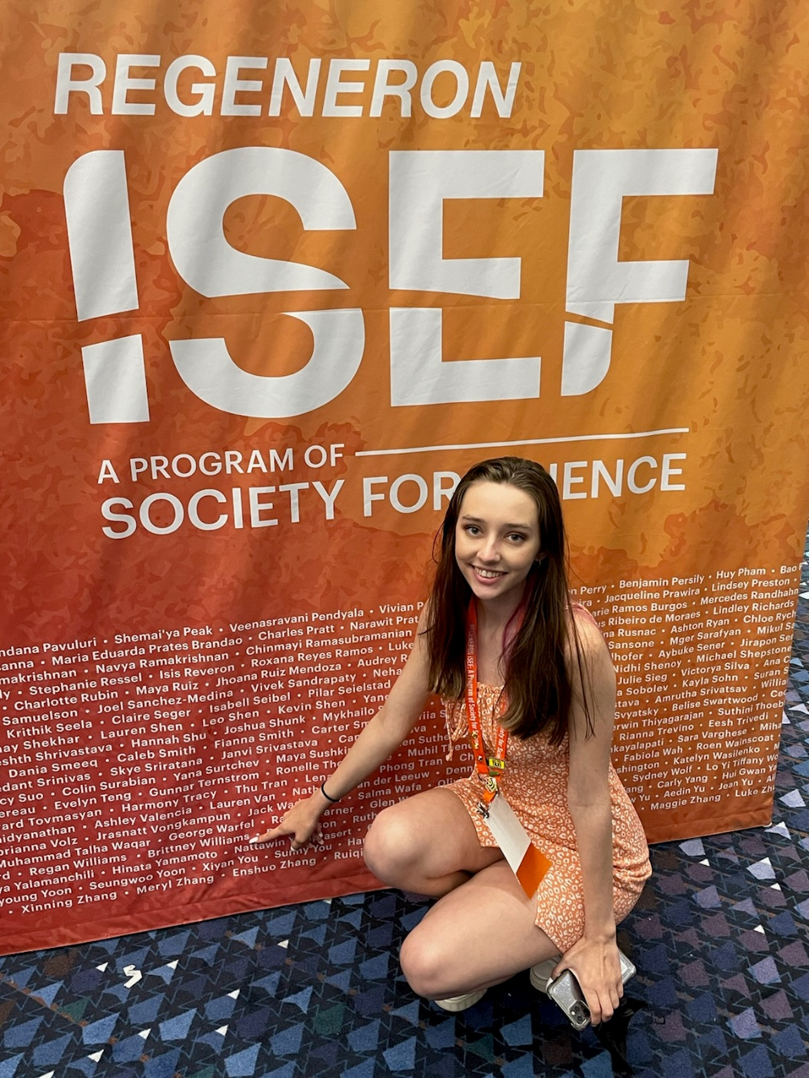
2022 MTSEF Grand Prize Winners– Ella Jane Brown and Brittney Williams at Regeneron ISEF in Atlanta, Georgia

